Slide 1
Day 1 & 2: Modeling Overview and Industry Applications
Notes:
Highlights: Introduce yourself and the session.
Key Takeaways: NA

Slide 2

Modeling Overview and Industry Applications
This is an introductory session on modeling overview, which will help to understand the application of modeling in different aspects of the business domain like:
Insurance
Banking
Healthcare
Procurement
In this session, we will cover modeling terminology and get to know each term in a nutshell to understand the different types of modeling such as:
Small data and large data
Use cases in various business domains
Model evaluation metrics

Slide 3
Modeling Overview and Industry Applications
On completion of the session, you will be able to
Describe statistical models
Discuss about machine learning and large data sets
Identify different types of machine learning – supervised, unsupervised, reinforcement learning
Describe the real-world applications of machine learning
Identify the methods used in machine learning such as train, test, validation, prediction etc.
Notes:
Duration: 2 minutes
Highlights: Connect the discussion to the topics for the day. Provide an overview the concepts and tasks that will be covered in the session. Introduce the session outcomes.
Key Takeaways: What should learners be able to do at the end of this session?

Slide 4
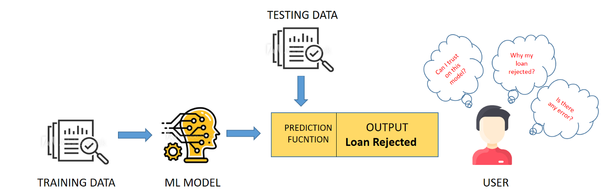
Machine Learning Models
Assume there is an activity in a bank to determine whether a customer is eligible for a loan or not. To examine and give the approval, bank employees were entrusted to do it manually. Now, to make the process faster, we are moving to data-driven decision-making algorithms, which are called models.
Previously, bank employees handled loan processing, but now they rely on machine learning models, which are a set of algorithms that learn patterns in pre-historical customer records and predict whether a new customer is eligible for a loan.
Notes:
Duration: 10 minutes
Highlights:
Introduce the definition.
Identify the unique attributes.
Provide examples to elaborate the concept and non-examples to show the difference.
Use whiteboard if required.
Key Takeaways:
In what ways, learners can use the concept in real-life situations to provide solutions or solve problems.

Slide 5
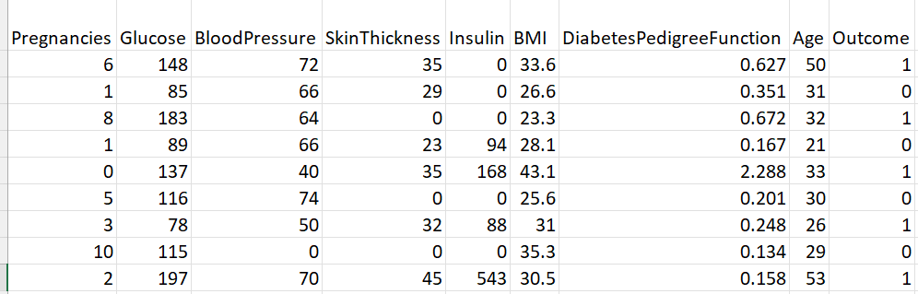
What Is a Model?
Assume you want a machine to determine whether a patient is diabetic. You must collect many observations, including patient records and a variety of data. Let’s have a look at the data.
Now, if the model is learning these several patterns in a random manner, then the algorithm will be able to predict whether, under the specified conditions, the patient will have diabetes or not. And it becomes very easy for the healthcare department to make data-driven decisions.
Notes:
Duration: 10 minutes
Highlights:
Introduce the definition.
Identify the unique attributes.
Provide examples to elaborate the concept and non-examples to show the difference.
Use whiteboard if required.
Key Takeaways:
In what ways, learners can use the concept in real-life situations to provide solutions or solve problems.

Slide 6
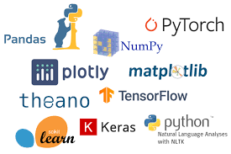
Implementation of the Modeling Techniques
These modeling techniques are implemented in Python. But this can also be developed in other languages too.
The reason we prefer Python to implement is because it is a popular and general-purpose programming language.
We can write machine learning algorithms using Python, and they work well.
Python is popular among data scientists is because it has a diverse variety of modules and libraries already implemented that make our lives more comfortable..
Notes:
Duration: 10 minutes
Highlights:
Introduce the definition.
Identify the unique attributes.
Provide examples to elaborate the concept and non-examples to show the difference.
Use whiteboard if required.
Key Takeaways:
In what ways, learners can use the concept in real-life situations to provide solutions or solve problems.

Slide 7
Some Recent Applications Of Modeling Techniques

Slide 8
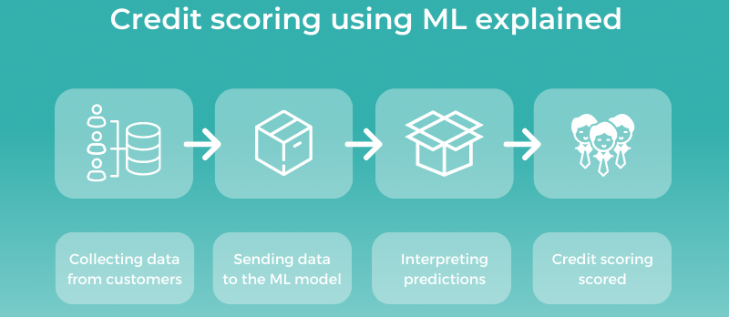
Machine Learning Models
Analytics is one of the biggest advantages of machine learning technology in the financial industry. And the fields of decision-making and credit scoring are getting the most benefits from it.
Banking institutions and other fintech firms use machine learning algorithms to perform their operations on the ML-based credit scoring system.
Notes:
Duration: 10 minutes
Highlights:
Introduce the definition.
Identify the unique attributes.
Provide examples to elaborate the concept and non-examples to show the difference.
Use whiteboard if required.
Key Takeaways:
In what ways, learners can use the concept in real-life situations to provide solutions or solve problems.

Slide 9
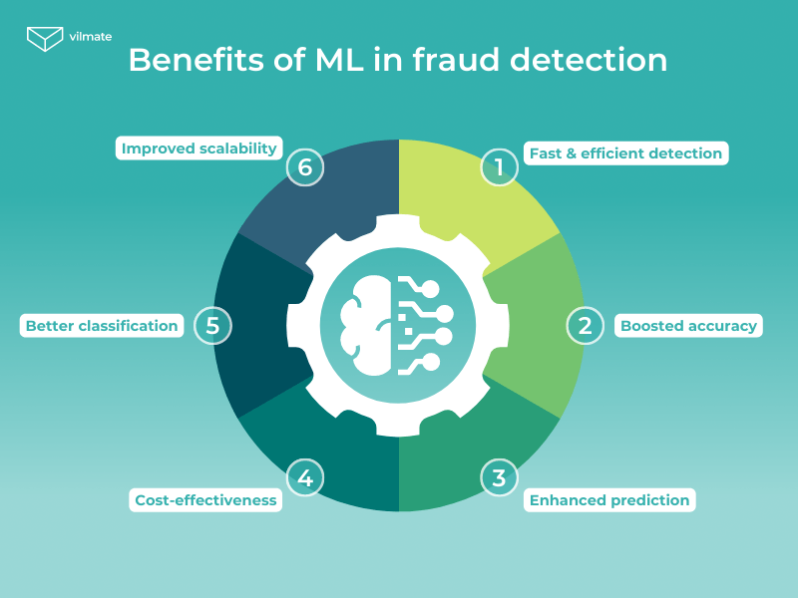
Security, Risk Management, and Fraud Detection
The three biggest concerns for fintech companies are fraud, security, and safety.
One should be perfectly aware of when and what to buy, what to sell, and when to hold in the market. The analytics feature in AI and ML makes these tasks a lot easier.
Notes:
Duration: 10 minutes
Highlights:
Introduce the definition.
Identify the unique attributes.
Provide examples to elaborate the concept and non-examples to show the difference.
Use whiteboard if required.
Key Takeaways:
In what ways, learners can use the concept in real-life situations to provide solutions or solve problems.

Slide 10
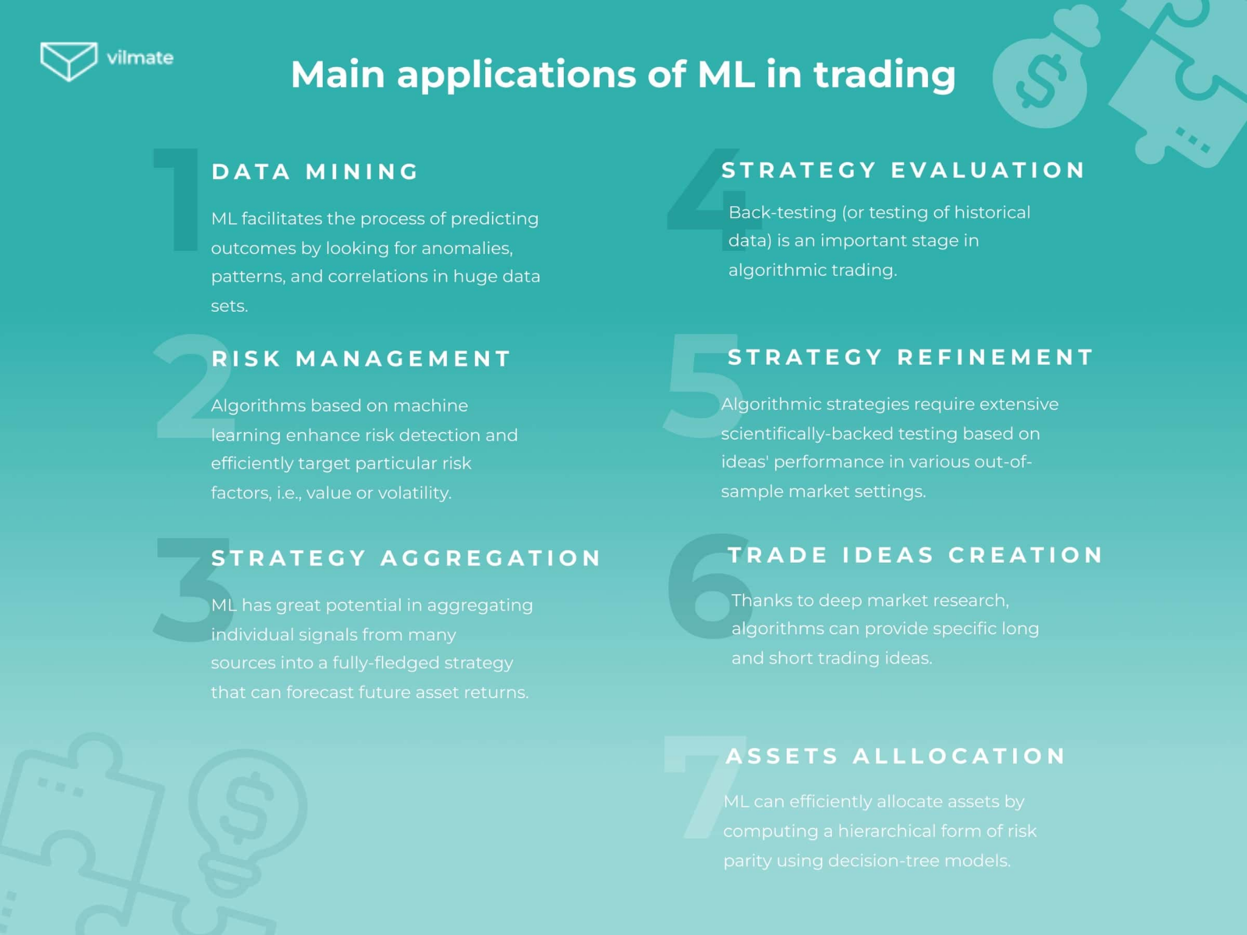
Quantitative and Algorithmic Trading
Building statistical models based on historical data can lead to more profitable investments faster than competitors.
Notes:
Duration: 10 minutes
Highlights:
Introduce the definition.
Identify the unique attributes.
Provide examples to elaborate the concept and non-examples to show the difference.
Use whiteboard if required.
Key Takeaways:
In what ways, learners can use the concept in real-life situations to provide solutions or solve problems.

Slide 11
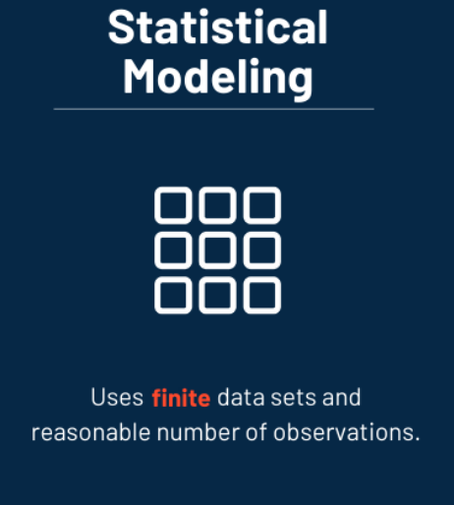
Statistical Models
Statistical modeling refers to the data science process of applying statistical analysis to datasets.
A statistical model is a mathematical relationship between one or more random variables and other non-random variables.
Notes:
Duration: 10 minutes
Highlights:
Introduce the definition.
Identify the unique attributes.
Provide examples to elaborate the concept and non-examples to show the difference.
Use whiteboard if required.
Key Takeaways:
In what ways, learners can use the concept in real-life situations to provide solutions or solve problems.

Slide 12
Why Statistical Model Is Used on Small Data?
Small Dataset Example
Height | Hair | Eyes | Class
short | blonde | blue | +
short | dark | blue | -
tall | dark | brown | -
tall | blonde | brown | -
tall | dark | blue | -
short | blonde | brown | -
tall | red | blue | +
tall | blonde | blue | +
Statistical models work with finite data sets and a reasonable number of observations.
Increasing the data might lead to overfitting (when statistical models fit against their training data).
On the contrary, machine learning models need vast amounts of data to learn and perform intelligent actions.
Notes:
Duration: 10 minutes
Highlights:
Introduce the definition.
Identify the unique attributes.
Provide examples to elaborate the concept and non-examples to show the difference.
Use whiteboard if required.
Key Takeaways:
In what ways, learners can use the concept in real-life situations to provide solutions or solve problems.

Slide 13

When Should You Use Statistical Modeling?
When data volume isn’t too large.
Errors and uncertainties in prediction are reasonable.
Independent variables have fewer, pre-specified interactions.
When it requires high interpretability.
When it requires the isolation of the effects of a small number of variables.
Notes:
Duration: 10 minutes
Highlights:
Introduce the definition.
Identify the unique attributes.
Provide examples to elaborate the concept and non-examples to show the difference.
Use whiteboard if required.
Key Takeaways:
In what ways, learners can use the concept in real-life situations to provide solutions or solve problems.

Slide 14
When Should You Use Statistical Modeling?
Example:
If a content marketing agency wants to build a model to track an audience’s journey, it will prefer a statistical model because, rather than accuracy, the interpretation is important.
It would help to develop an engagement strategy based on business domain knowledge.
Notes:
Duration: 10 minutes
Highlights:
Introduce the definition.
Identify the unique attributes.
Provide examples to elaborate the concept and non-examples to show the difference.
Use whiteboard if required.
Key Takeaways:
In what ways, learners can use the concept in real-life situations to provide solutions or solve problems.

Slide 15

Machine Learning and Large Data
Machine learning is a method of data analysis that automates the building of analytical models.
It is a branch of artificial intelligence based on the idea that systems can learn from data, identify patterns, and make decisions with minimal human intervention.
Notes:
Duration: 10 minutes
Highlights:
Introduce the definition.
Identify the unique attributes.
Provide examples to elaborate the concept and non-examples to show the difference.
Use whiteboard if required.
Key Takeaways:
In what ways, learners can use the concept in real-life situations to provide solutions or solve problems.

Slide 16

Decision-Making and Credit Scoring
Analytics is one of the biggest advantages that machine learning technology provides in the financial industry. And the fields of decision-making and credit scoring are getting the most benefits from it.
Banking institutions & other fintech firms use machine learning algorithms to render their operations on the ML Based credit scoring system.
Notes:
Duration: 10 minutes
Highlights:
Introduce the definition.
Identify the unique attributes.
Provide examples to elaborate the concept and non-examples to show the difference.
Use whiteboard if required.
Key Takeaways:
In what ways, learners can use the concept in real-life situations to provide solutions or solve problems.

Slide 17
Example
Machine learning models are computer programs that are used to recognize patterns in data or make predictions.
Models are created from algorithms, which are trained using either labeled, unlabeled, or mixed data.
Different machine learning algorithms are suited to different goals, such as classification or prediction modeling, so data scientists use different algorithms as the basis for different models.
Notes:
Duration: 10 minutes
Highlights:
Introduce the definition.
Identify the unique attributes.
Provide examples to elaborate the concept and non-examples to show the difference.
Use whiteboard if required.
Key Takeaways:
In what ways, learners can use the concept in real-life situations to provide solutions or solve problems.

Slide 18
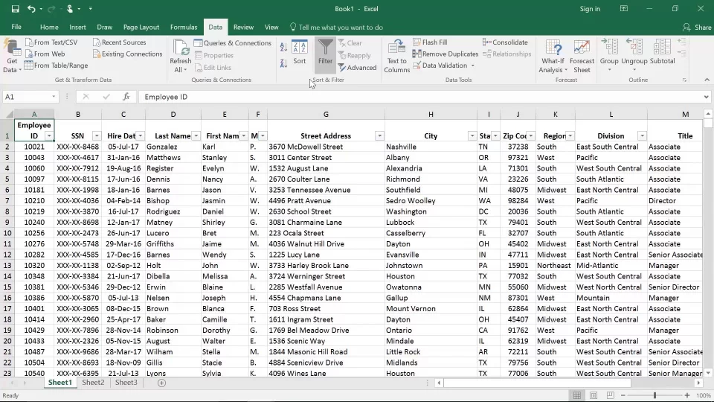
Why Is a Machine Learning Model Applied to Large Amounts of Data?
More complex algorithms always require a larger amount of data. If your project needs standard ML algorithms that use structured learning, a smaller amount of data will be enough. Even if you feed the algorithm more data than it needs, the results won't improve drastically.
Large Dataset Example
Notes:
Duration: 10 minutes
Highlights:
Introduce the definition.
Identify the unique attributes.
Provide examples to elaborate the concept and non-examples to show the difference.
Use whiteboard if required.
Key Takeaways:
In what ways, learners can use the concept in real-life situations to provide solutions or solve problems.

Slide 19
When Should You Use Machine Learning?
Training learning algorithms on infinite data replications
The goal is to get overall predictions, not relationships between variables.
Estimating uncertainties in forecasts isn’t essential.
The effect of any variable doesn’t need to be isolated.
Notes:
Duration: 10 minutes
Highlights:
Introduce the definition.
Identify the unique attributes.
Provide examples to elaborate the concept and non-examples to show the difference.
Use whiteboard if required.
Key Takeaways:
In what ways, learners can use the concept in real-life situations to provide solutions or solve problems.

Slide 20

When Should You Use Machine Learning?
Example:
When an e-commerce website such as Amazon wants to recommend products based on previous purchases, they need a powerful recommendation engine. Here, the need for predictive accuracy is more important than the model’s interpretability.
In this case, we use a machine learning model.
Notes:
Duration: 10 minutes
Highlights:
Introduce the definition.
Identify the unique attributes.
Provide examples to elaborate the concept and non-examples to show the difference.
Use whiteboard if required.
Key Takeaways:
In what ways, learners can use the concept in real-life situations to provide solutions or solve problems.

Slide 21
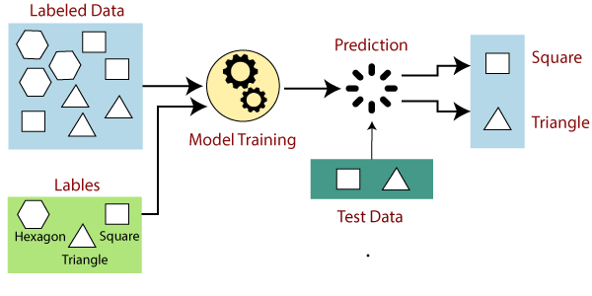
Introduction to Machine Learning
Machine learning is a subfield of artificial intelligence (AI).
Machine Learning aims to understand the structure of data and fit that data into models that can be understood and utilized by people.
Notes:
Duration: 10 minutes
Highlights:
Introduce the definition.
Identify the unique attributes.
Provide examples to elaborate the concept and non-examples to show the difference.
Use whiteboard if required.
Key Takeaways:
In what ways, learners can use the concept in real-life situations to provide solutions or solve problems.

Slide 22
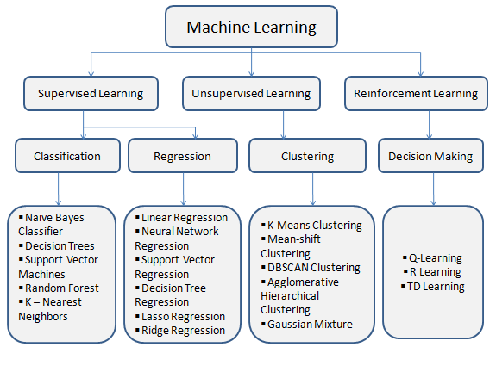
Types of Machine Learning
Notes:
Duration: 10 minutes
Highlights:
Introduce the definition.
Identify the unique attributes.
Provide examples to elaborate the concept and non-examples to show the difference.
Use whiteboard if required.
Key Takeaways:
In what ways, learners can use the concept in real-life situations to provide solutions or solve problems.

Slide 23
Types of Machine Learning
Machine Learning
Supervised Learning
Unsupervised Learning
Reinforcement Learning
Classification
Regression
Clustering
Decision Making
Naïve Bayes Classifier
Decision Tres
Support Vector Machines
Random Forest
K – Nearest Neighbours
Linear Regression
Neural Network Regression
Decision Tree Regression
Lasso Regression
Ridge Regression
K-Means Clustering
Mean-shift Clustering
DBSCAN Clustering
Agglomerative Hierarchical Clustering
Gaussian Mixture
Q-Learning
R-Learning
TD Learning
Notes:
Duration: 10 minutes
Highlights:
Introduce the definition.
Identify the unique attributes.
Provide examples to elaborate the concept and non-examples to show the difference.
Use whiteboard if required.
Key Takeaways:
In what ways, learners can use the concept in real-life situations to provide solutions or solve problems.

Slide 24
Industry Specific Applications - Machine Learning
Machine Learning Applications in Finance
Analysts use machine learning in the financial services sector to automate trading activities, detect fraud, and provide financial advising services to their clients.
Machine Learning Applications in Business
Machine learning offers businesses an extensive number of ways to boost their effectiveness, efficiency, and offerings. Chatbots, for example, allows businesses to provide faster, more flexible customer service without employing a call center or making customers wait on hold for the next available representative.
Machine Learning Applications in Retail
As we’ve already mentioned, machine learning can be incredibly helpful in understanding and decreasing customer churn (i.e., the rate at which a business loses customers each year), which is a large focus point for many retail companies.
Notes:
Duration: 10 minutes
Highlights:
Introduce the definition.
Identify the unique attributes.
Provide examples to elaborate the concept and non-examples to show the difference.
Use whiteboard if required.
Key Takeaways:
In what ways, learners can use the concept in real-life situations to provide solutions or solve problems.

Slide 25

Real-World Examples: Machine Learning
Image recognition
Image recognition is a well-known and widespread example of machine learning in the real world. It can identify an object as a digital image based on the intensity of the pixels in black-and-white or color images.
Speech recognition
Machine learning can translate speech into text. Certain software applications can convert live voice and recorded speech into a text file.
Medical diagnosis
Machine learning can help with the diagnosis of diseases. Many physicians use chatbots with speech recognition capabilities to discern patterns in symptoms.
Notes:
Duration: 10 minutes
Highlights:
Introduce the definition.
Identify the unique attributes.
Provide examples to elaborate the concept and non-examples to show the difference.
Use whiteboard if required.
Key Takeaways:
In what ways, learners can use the concept in real-life situations to provide solutions or solve problems.

Slide 26
Real-World Examples: Machine Learning
Statistical arbitrage
Arbitrage is an automated trading strategy used in finance to manage a large volume of securities.
Predictive analytics
Machine learning can classify available data into groups, which are then defined by rules set by analysts.
Notes:
Duration: 10 minutes
Highlights:
Introduce the definition.
Identify the unique attributes.
Provide examples to elaborate the concept and non-examples to show the difference.
Use whiteboard if required.
Key Takeaways:
In what ways, learners can use the concept in real-life situations to provide solutions or solve problems.

Slide 27
What is the difference between supervised learning and unsupervised learning?
Dataset with target labels.
Dataset without target labels.
Machine learning model requires small data in complex algorithms.
True
False
Statistical models work on _______ data/ observations.

Slide 28
Methods of Machine Learning
Data Splitting Techniques
Original Labelled Data
Training Set
Validation Set
Test Set
Notes:
Duration: 10 minutes
Highlights:
Introduce the definition.
Identify the unique attributes.
Provide examples to elaborate the concept and non-examples to show the difference.
Use whiteboard if required.
Key Takeaways:
In what ways, learners can use the concept in real-life situations to provide solutions or solve problems.

Slide 29
Methods of Machine Learning
Data Splitting Techniques
Training set: The data you will use to train your model will be fed into an algorithm that generates a model. This model maps inputs to outputs.
Validation set: This is smaller than the training set and is used to evaluate the performance of models with different hyperparameter values. It's also used to detect overfitting during the training stages.
Test set: This set is used to get an idea of the final performance of a model after hyperparameter tuning. It's also useful to get an idea of how different models (SVMs, neural networks, random forests, etc.) perform against each other.
Notes:
Duration: 10 minutes
Highlights:
Introduce the definition.
Identify the unique attributes.
Provide examples to elaborate the concept and non-examples to show the difference.
Use whiteboard if required.
Key Takeaways:
In what ways, learners can use the concept in real-life situations to provide solutions or solve problems.

Slide 30
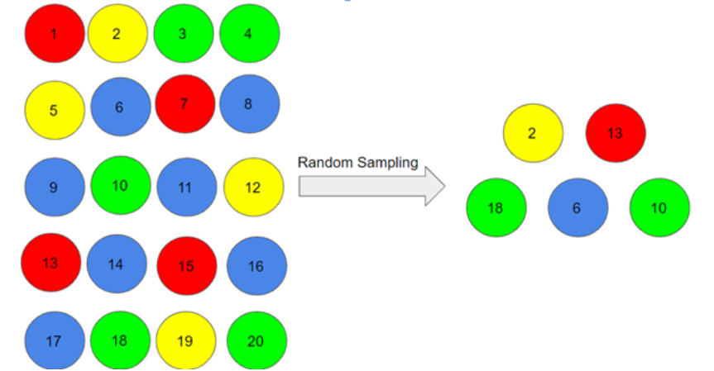
Random Selection
Random Selection
A random sample is a subset of a statistical population, whereas the subset should represent the entire population accurately and equally. To ensure that the sample is random, it is important that the population from which the data comes is stable.
Notes:
Duration: 10 minutes
Highlights:
Introduce the definition.
Identify the unique attributes.
Provide examples to elaborate the concept and non-examples to show the difference.
Use whiteboard if required.
Key Takeaways:
In what ways, learners can use the concept in real-life situations to provide solutions or solve problems.

Slide 31
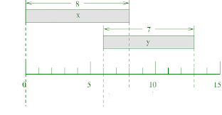
Temporal Selection
Temporal Selection
Temporal data is simply data that represents a state in time, such as the land-use patterns of Hong Kong in 1990 or the total rainfall in Honolulu on July 1, 2009. Temporal data is collected to analyze weather patterns and other environmental variables, monitor traffic conditions, study demographic trends, and so on.
Notes:
Duration: 10 minutes
Highlights:
Introduce the definition.
Identify the unique attributes.
Provide examples to elaborate the concept and non-examples to show the difference.
Use whiteboard if required.
Key Takeaways:
In what ways, learners can use the concept in real-life situations to provide solutions or solve problems.

Slide 32
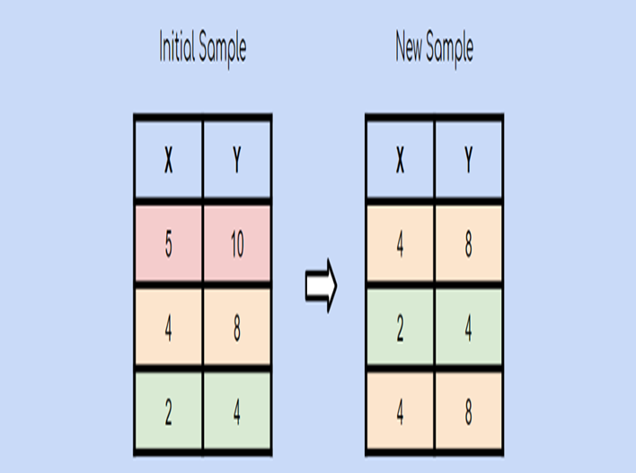
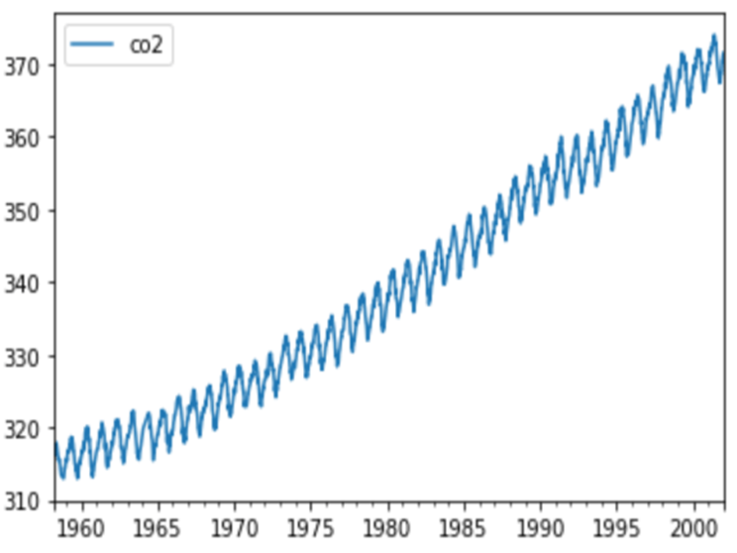
Understanding Random and Temporal Selection in Machine Learning
Random Data Selection is a subset of data from the entire population that aids in inputting data into models with some random effect to understand the prediction in all possible ways.
Temporal data selection is time series-driven, which means it aids in the preparation of data sets that change over time.
Notes:
Duration: 10 minutes
Highlights:
Introduce the definition.
Identify the unique attributes.
Provide examples to elaborate the concept and non-examples to show the difference.
Use whiteboard if required.
Key Takeaways:
In what ways, learners can use the concept in real-life situations to provide solutions or solve problems.

Slide 33
Random Seeds in Machine Learning
A random seed is used to ensure that results are reproducible. In other words, using this parameter ensures that anyone who runs your code again will get the same results. Reproducibility is an extremely important concept in data science and other fields.
There are two common tasks where they are used:
Splitting data into training, validation, and test sets: Random seeds ensure that the data is divided the same way every time the code is run.
Model training: Algorithms such as random forest and gradient boosting are non-deterministic (for a given input, the output is not always the same) and so require a random seed argument for reproducible results.
Notes:
Duration: 10 minutes
Highlights:
Introduce the definition.
Identify the unique attributes.
Provide examples to elaborate the concept and non-examples to show the difference.
Use whiteboard if required.
Key Takeaways:
In what ways, learners can use the concept in real-life situations to provide solutions or solve problems.

Slide 34
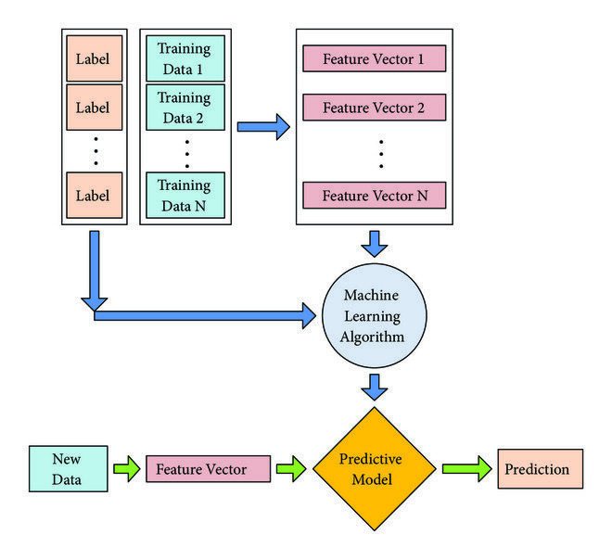
Prediction in Machine Learning
Prediction essentially means to predict a future outcome, similarly to what is accomplished in machine learning.
It refers to the output of an algorithm after training on a historical data set.
After learning the historical data set, prediction makes it possible to forecast the outcome of a new data set.
Notes:
Duration: 10 minutes
Highlights:
Introduce the definition.
Identify the unique attributes.
Provide examples to elaborate the concept and non-examples to show the difference.
Use whiteboard if required.
Key Takeaways:
In what ways, learners can use the concept in real-life situations to provide solutions or solve problems.

Slide 35
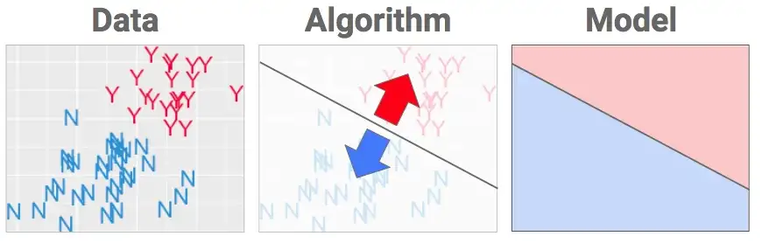
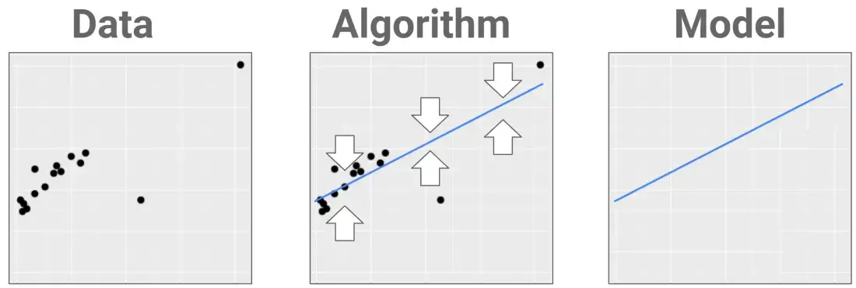
Prediction on Data in Machine Learning
Classification
What we have here is a dataset that is labeled with two classes (Y and N). In other words, the algorithm must put a fence in the data to best separate the Ys from the Ns. Our goal is to create a model that can be used to classify new examples correctly.
Regression
It is often used as a prediction where the model tries to predict any variables that are continuous in nature, such as demand forecasting, sales forecasting, etc.
Notes:
Duration: 10 minutes
Highlights:
Introduce the definition.
Identify the unique attributes.
Provide examples to elaborate the concept and non-examples to show the difference.
Use whiteboard if required.
Key Takeaways:
In what ways, learners can use the concept in real-life situations to provide solutions or solve problems.

Slide 36
Prediction in Machine Learning
Prediction essentially means to predict a future outcome, like what is accomplished in machine learning.
It refers to the output of an algorithm after training on a historical data set.
After learning the historical data set, prediction makes it possible to forecast the outcome of a new data set.
Notes:
Duration: 10 minutes
Highlights:
Introduce the definition.
Identify the unique attributes.
Provide examples to elaborate the concept and non-examples to show the difference.
Use whiteboard if required.
Key Takeaways:
In what ways, learners can use the concept in real-life situations to provide solutions or solve problems.

Slide 37
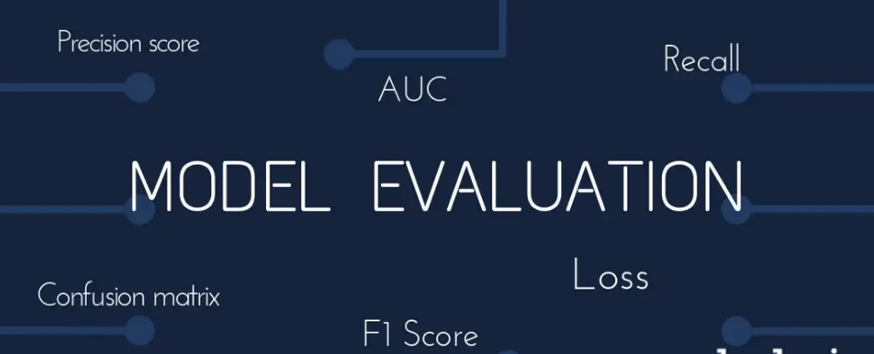
Evaluation in Machine Learning
Model evaluation is the process of using different evaluation metrics to understand a machine learning model's performance as well as its strengths and weaknesses.
Notes:
Duration: 10 minutes
Highlights:
Introduce the definition.
Identify the unique attributes.
Provide examples to elaborate the concept and non-examples to show the difference.
Use whiteboard if required.
Key Takeaways:
In what ways, learners can use the concept in real-life situations to provide solutions or solve problems.

Slide 38
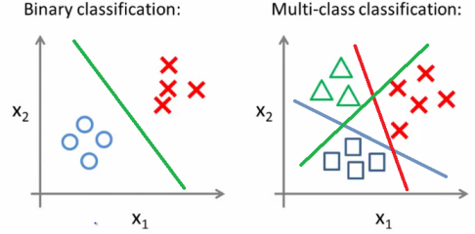
Evaluating Multiclass Classifier Performance
Classification is the process of assigning any new data point to a set of categories (sub-populations) based on a mapping function.
This function is derived from a training set of data where category membership is known for each observation.
Notes:
Duration: 10 minutes
Highlights:
Introduce the definition.
Identify the unique attributes.
Provide examples to elaborate the concept and non-examples to show the difference.
Use whiteboard if required.
Key Takeaways:
In what ways, learners can use the concept in real-life situations to provide solutions or solve problems.

Slide 39
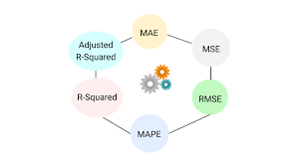
Evaluating Regression Model’s Performance
Regression refers to predictive modeling problems that involve predicting a numeric value. It is different from classification, which involves predicting a class label.
Unlike classification, you cannot use classification accuracy to evaluate the predictions made by a regression model.
Instead, you must use error metrics specifically designed for evaluating predictions made on regression problems.
Notes:
Duration: 10 minutes
Highlights:
Introduce the definition.
Identify the unique attributes.
Provide examples to elaborate the concept and non-examples to show the difference.
Use whiteboard if required.
Key Takeaways:
In what ways, learners can use the concept in real-life situations to provide solutions or solve problems.

Slide 40
A bank hires a data analyst to analyze the pre-historical dataset of customer records to determine whether the customers will churn. What will his or her modeling methodology be for the dataset?
Classification
Regression
Clustering
Reinforcement learning

Slide 41
A large retail store company wants to analyze the sales forecasting for the 52 outlets it has in the Northeast region. Each store generates approximately 3 GB of data per day; as a data scientist, what modeling technique would you choose if you were tasked with sales forecasting?
Statistical modeling
Deep learning and modeling
Modeling with Machine Learning and Deep Learning

